Slide 1

Workshop on
Hardware based Attacks & Defenses
Module 1
Patanjali SLPSK
Postdoctoral Researcher
Electrical and Computer Engineering Department
University of Florida

Slide 2

Outline
Hardware security
Why Hardware Security?
Trust Issues in the Supply chain
Challenges for Trustworthy Hardware
LinkedIn

Slide 3

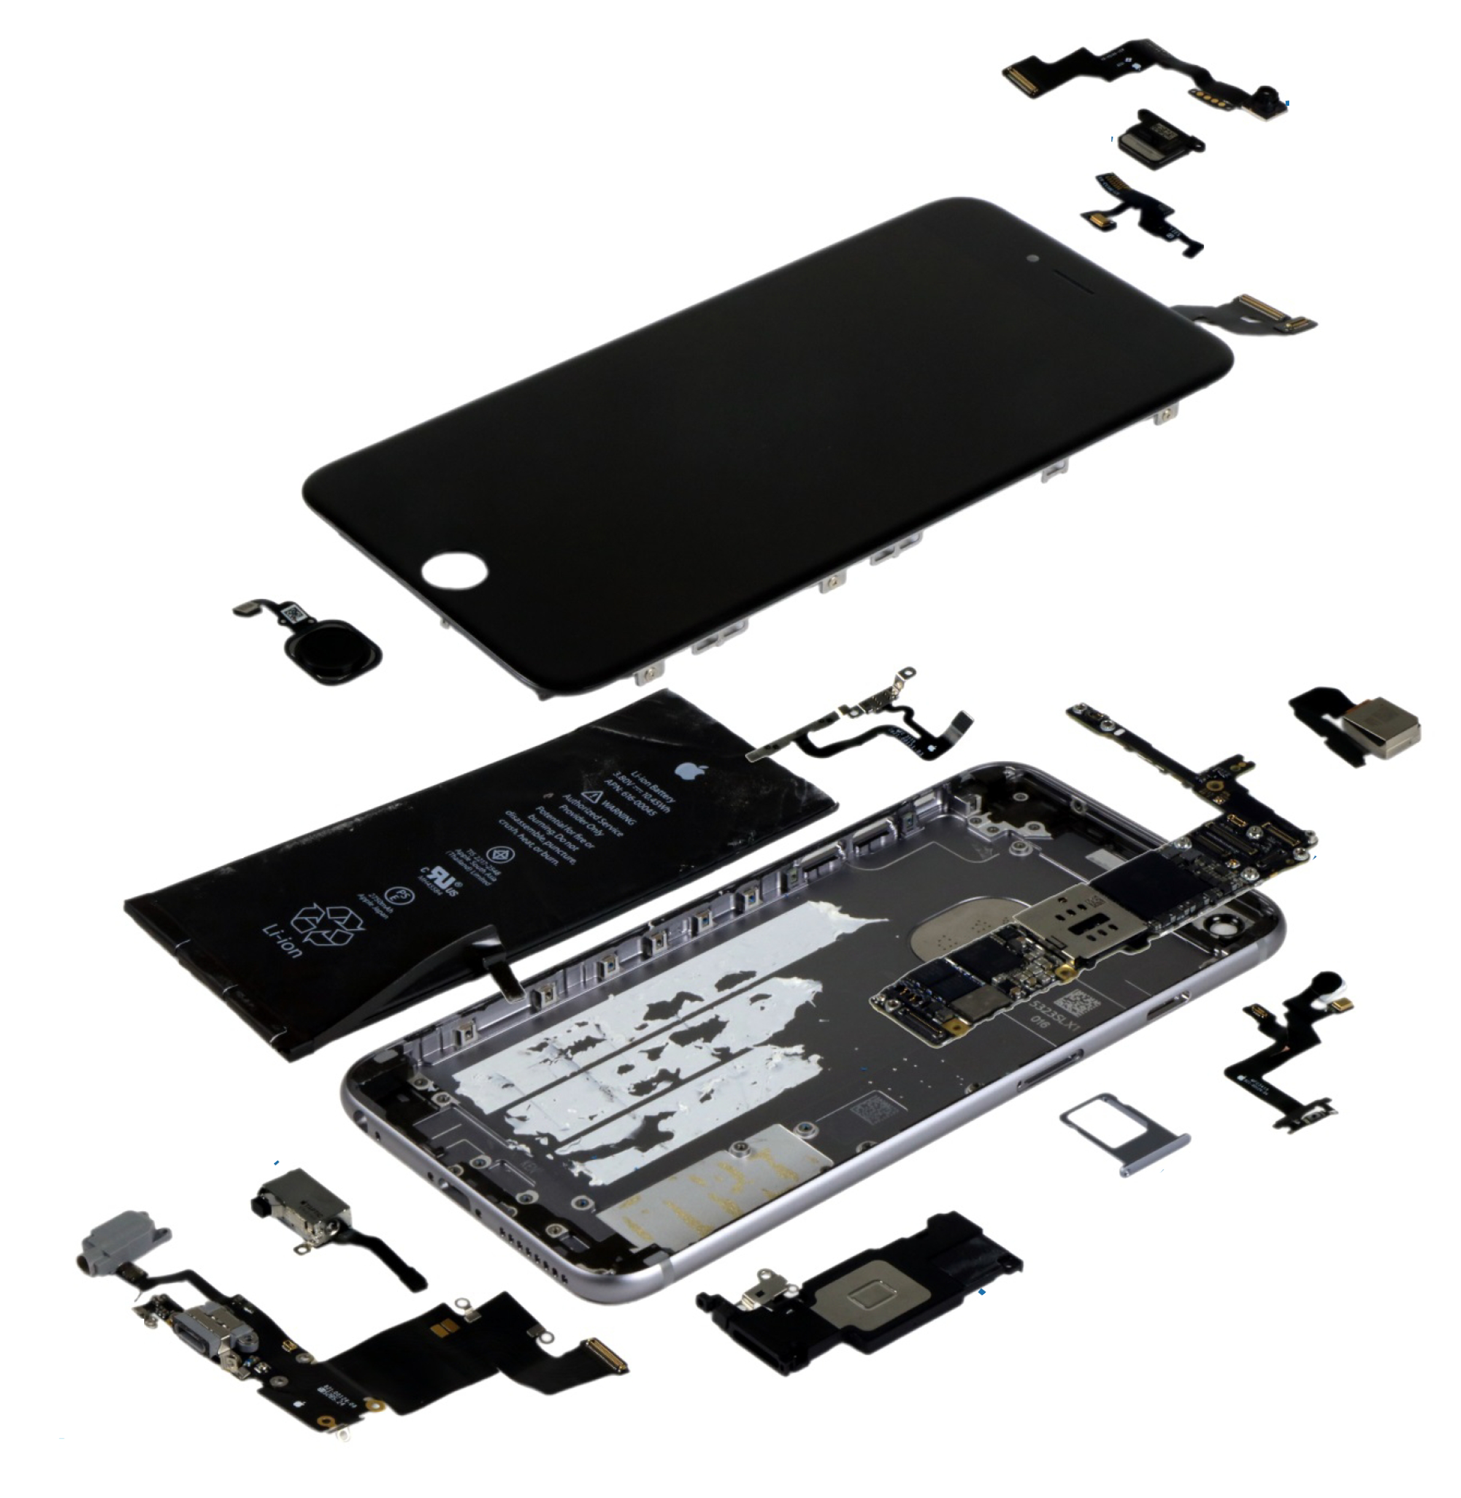
Why Hardware Security?
Today’s hardware design complex entities with hundreds of moving parts
The chip designer has to meet:
Complex user requirements
Challenges of manufacturing at lower nanometer nodes
Aggressive time-to-market demands
LinkedIn

Slide 4
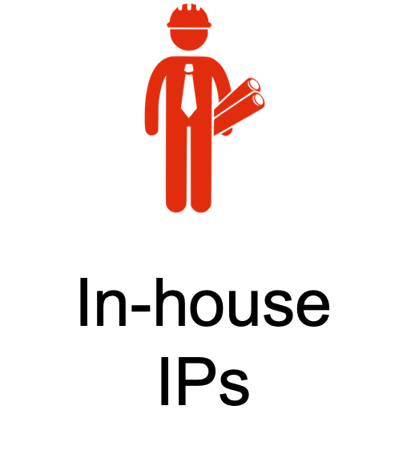
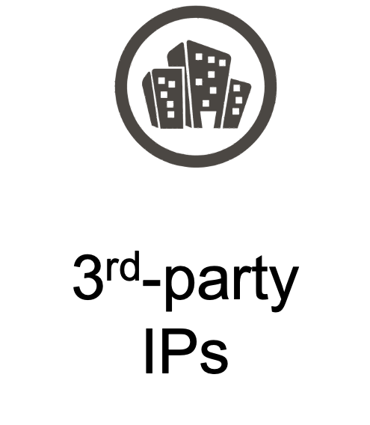
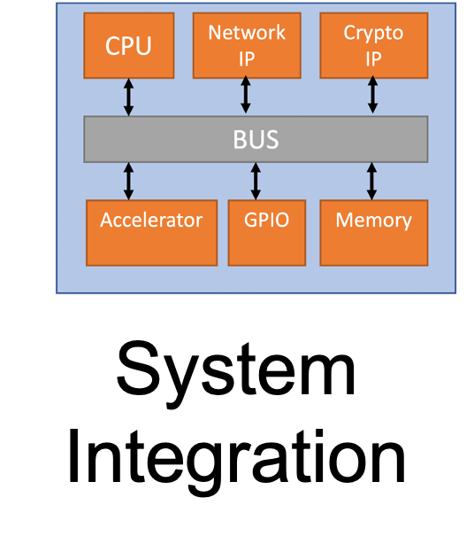
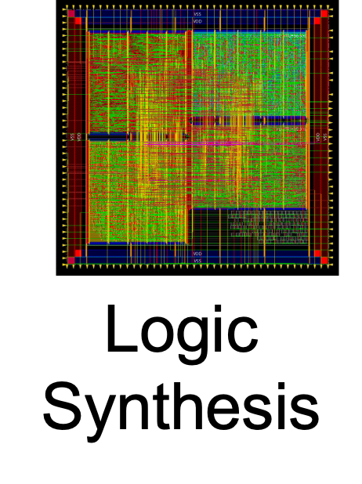
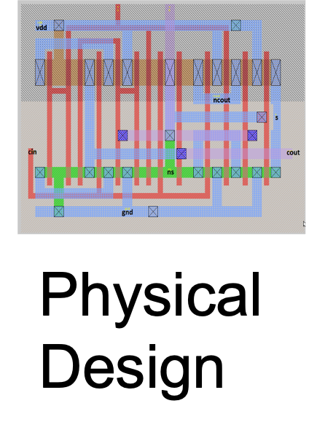
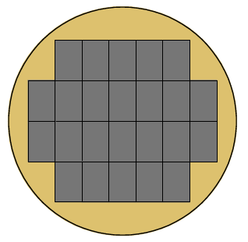
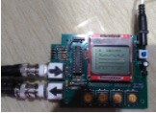
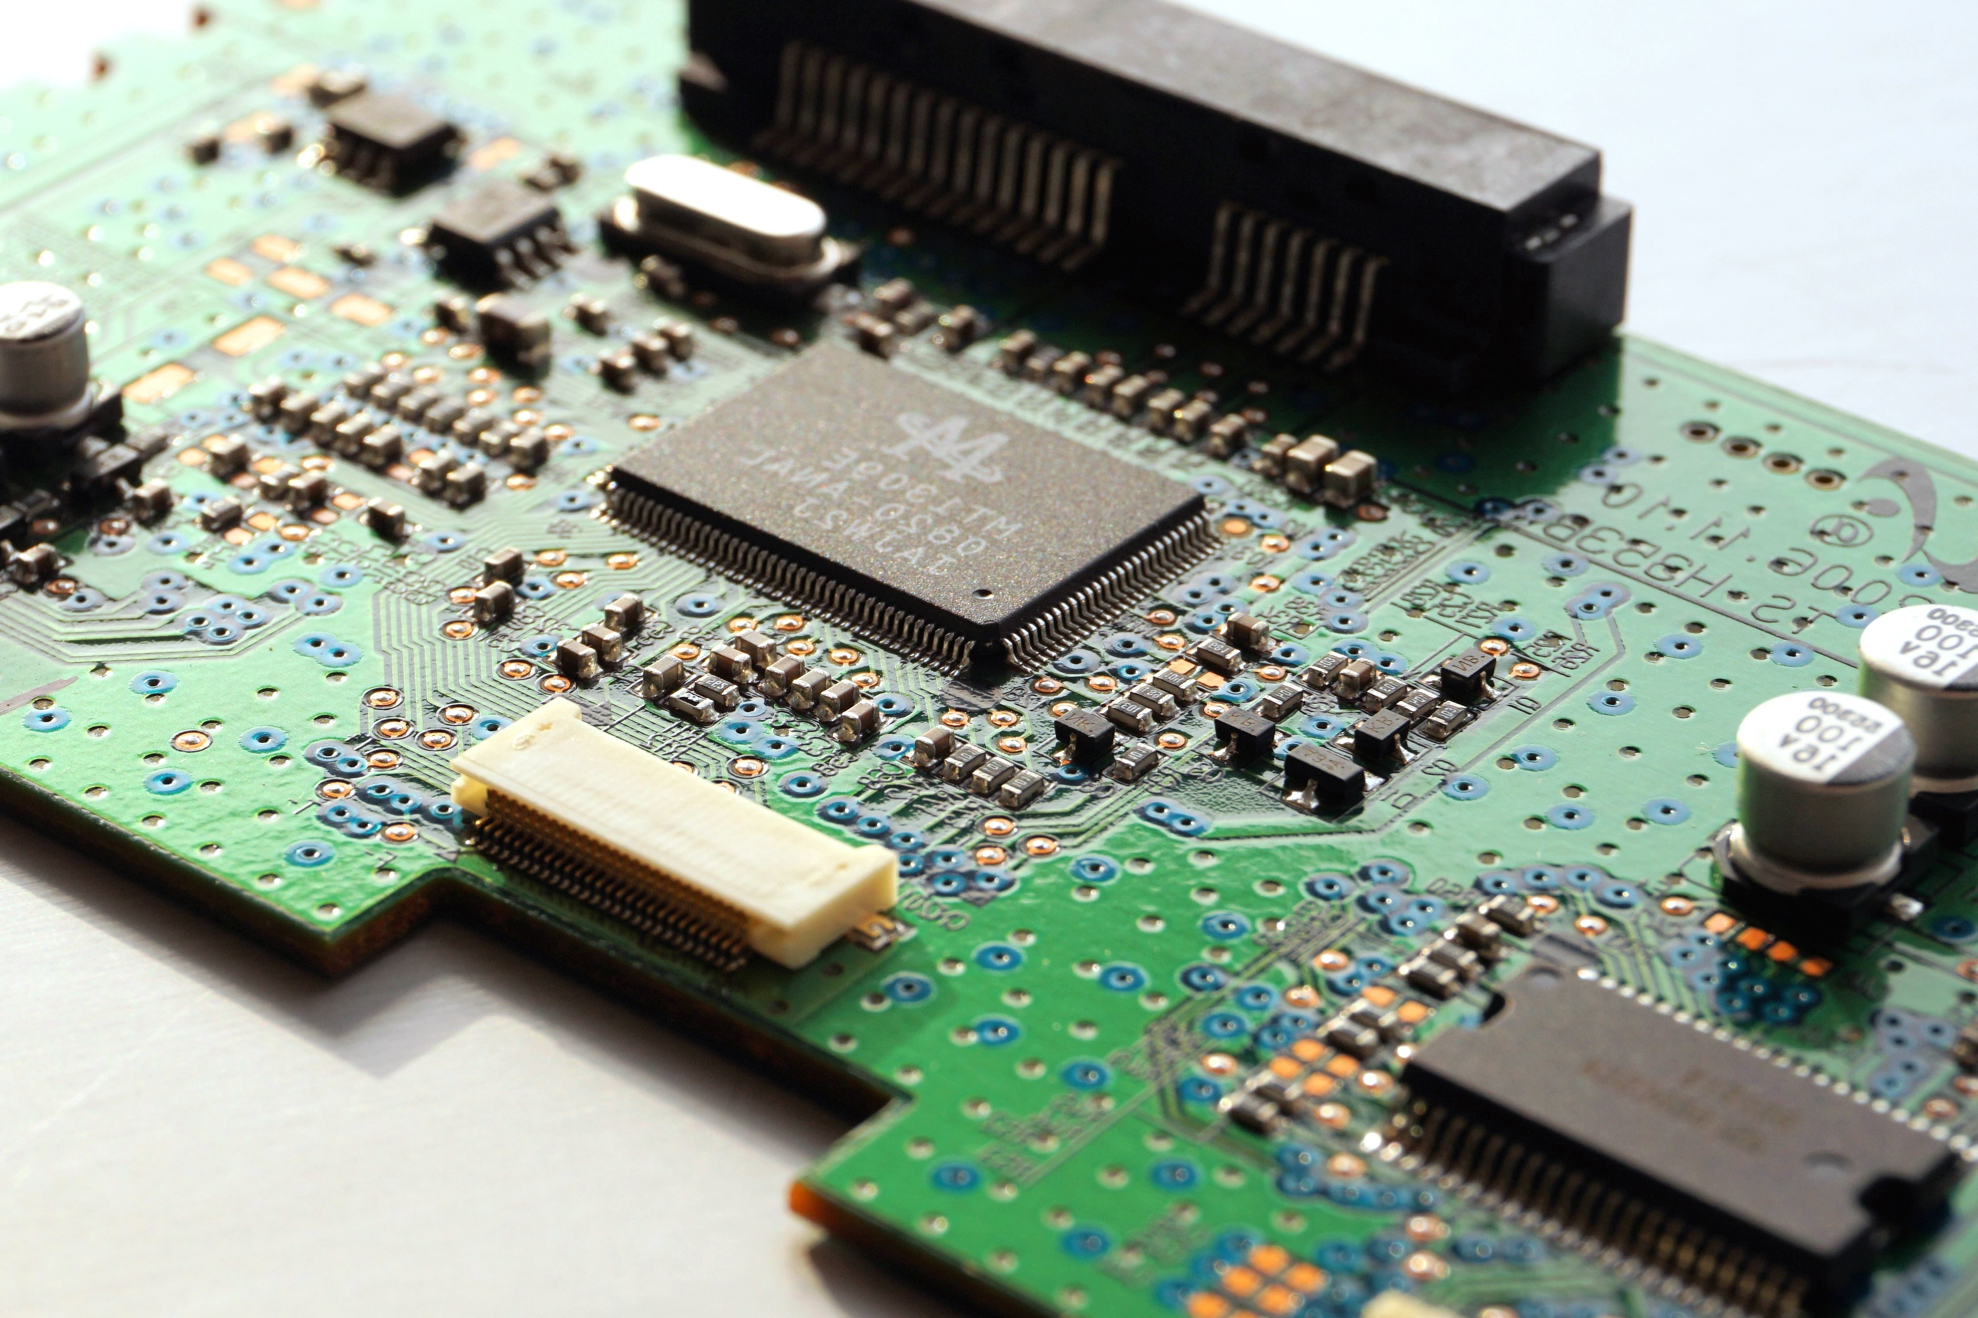
Why Hardware Security ?
Semiconductor Supply chain
IP Acquisition
System Integration
Fabrication
Testing
Field
Distributed model => multiple entities each focusing on a dedicated aspect of the design process
Instead of designing IPs in-house use pre-designed models
Foundry focusses on lower nanometer challenges
System Integrator can operate as a “fabless” entity and reduce cost
Easily meet time-to-market demands
Cons: Multiple entities, across the globe => Trust Issues
LinkedIn

Slide 5
Trust Issues in Supply Chain
Semiconductor Supply chain
IP Acquisition
System Integration
Fabrication
Testing
Field
Trust Issues
Extraction of Design Secrets
Trojans
Extraction of Design Secrets
Extraction of Design Secrets
Extraction of Design Secrets
Trojans
Trojans
Piracy /Counterfeiting
Reverse-Engineering
Piracy /Counterfeiting
Piracy /Counterfeiting
Reverse-Engineering
Reverse-Engineering
Side-channels
LinkedIn

Slide 6
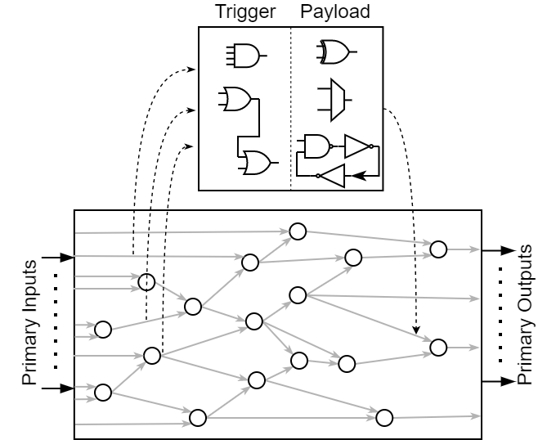
Trust Issues in Supply Chain
Semiconductor Supply chain
IP Acquisition
System Integration
Fabrication
Testing
Field
Trojans
LinkedIn

Slide 7
Trust Issues in Supply Chain
Semiconductor Supply chain
IP Acquisition
System Integration
Fabrication
Testing
Field
Piracy/Counterfeiting
LinkedIn

Slide 8
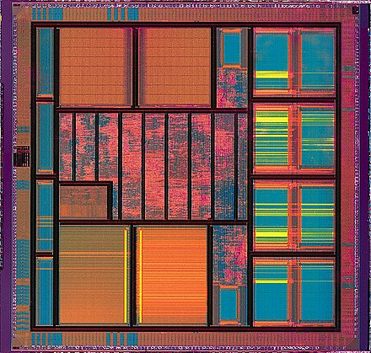
Trust Issues in Supply Chain
Semiconductor Supply chain
IP Acquisition
System Integration
Fabrication
Testing
Field
Reverse-Engineering
LinkedIn

Slide 9
Trust Issues in Supply Chain
Semiconductor Supply chain
IP Acquisition
System Integration
Fabrication
Testing
Field
Extraction of Design Secrets
0xd3adc4fe
LinkedIn

Slide 10







Trust Issues in Supply Chain
Semiconductor Supply chain
IP Acquisition
System Integration
Fabrication
Testing
Field
Side-channel attacks
LinkedIn

Slide 11
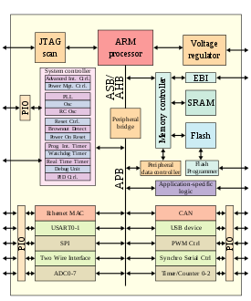
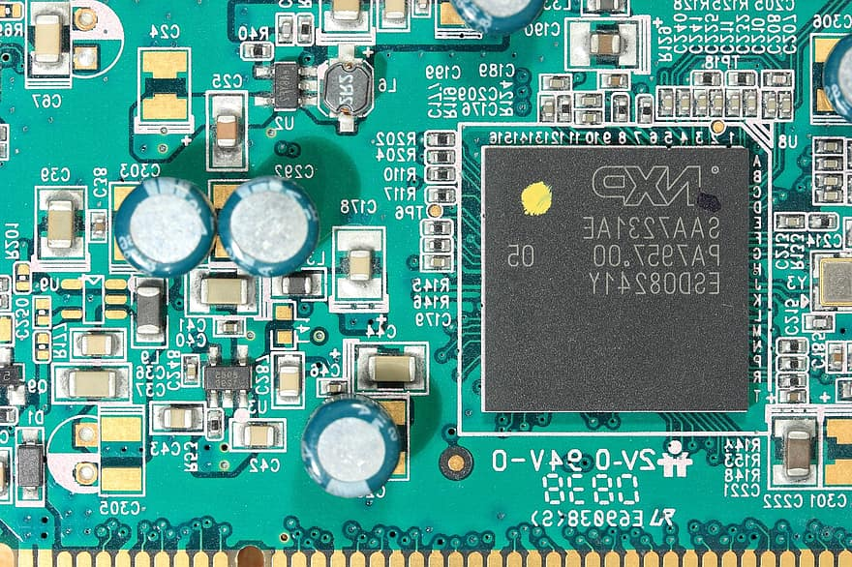
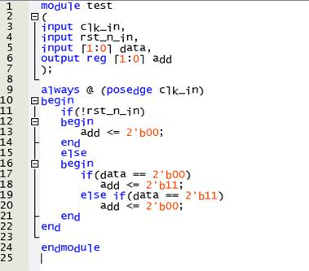
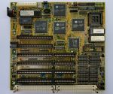
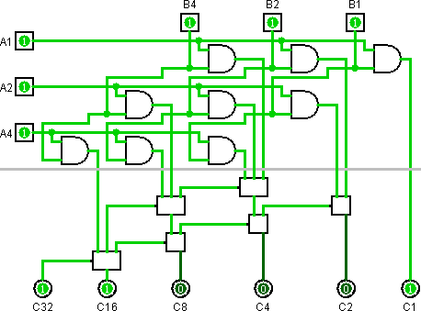
Challenges for Trustworthy Hardware
Semiconductor Supply chain
IP Acquisition
System Integration
Fabrication
Testing
Field
Design Transformation
System Integration
Gate-level netlist
Physical Design
Fabricated Design
Packaged IC
RTL
Challenge 1:
Any security solution must remain immutable to design transformation
Must respect the design constraints at each stage
LinkedIn

Slide 12
Challenges for Trustworthy Hardware
Design Transformation
System Integration
Gate-level netlist
Physical Design
Fabricated Design
Packaged IC
RTL
Design Constraints
Functionality, Power Performance and Area
Functional Correctness
Functionality
Functionality
Challenge 2:
Current Design Flows do not allow for security optimizations
Security Integration is a separate process that needs to happen at each stage
LinkedIn

Slide 13
Challenges for Trustworthy Hardware
Optimize Design
For target goal
Check for overhead
Identify vulnerable regions
Deploy targeted countermeasure
Challenge 3:
Integrating security separately impacts the design constraints
Creates a cyclic dependency between design constraints and security
LinkedIn

Slide 14
Challenges for Trustworthy Hardware
ns
J
Sq.mm
GBps
Hz
FLOPS
W
rpm
Gates/sq.mm
??
MBps
Cycle count
W/mm
MB/GB
W/cycle
#AND gates
Delay
Power
Area
Memory
Security
Challenge 4:
Lack of a security metric makes it harder for design optimization
EDA tools can only optimize for power, performance or area not security
Makes it harder to quantify the impact of EDA optimizations on security
LinkedIn

Slide 15

Challenges for Trustworthy Hardware
Detection Countermeasures
IP Acquisition
System Integration
Fabrication
Testing
Field
Prevention Countermeasures
IP Acquisition
System Integration
Fabrication
Testing
Field
Challenge 5:
To Trust or not to Trust?
Attacks in the upstream supply chain require detection techniques
Attacks in the downstream supply chain require prevention techniques
LinkedIn

Slide 16
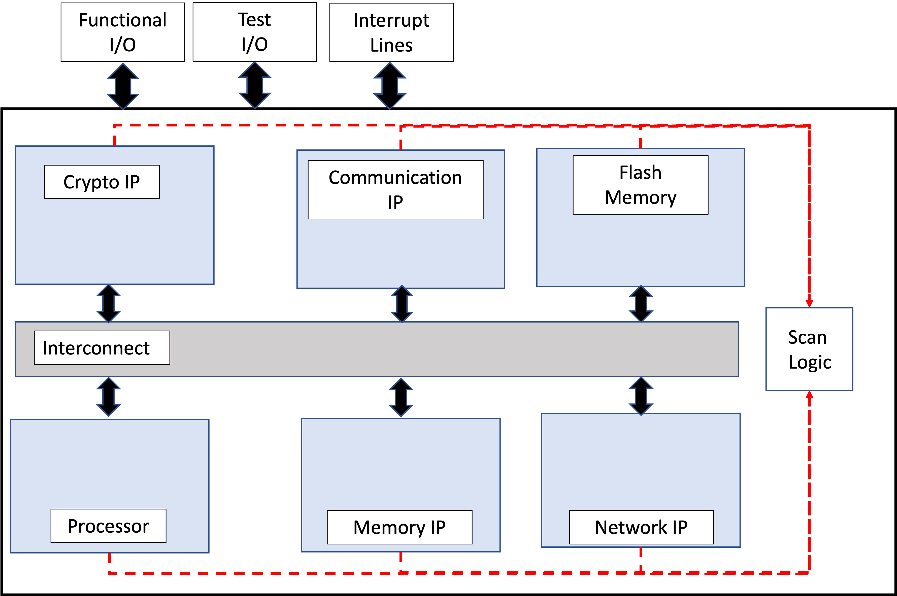
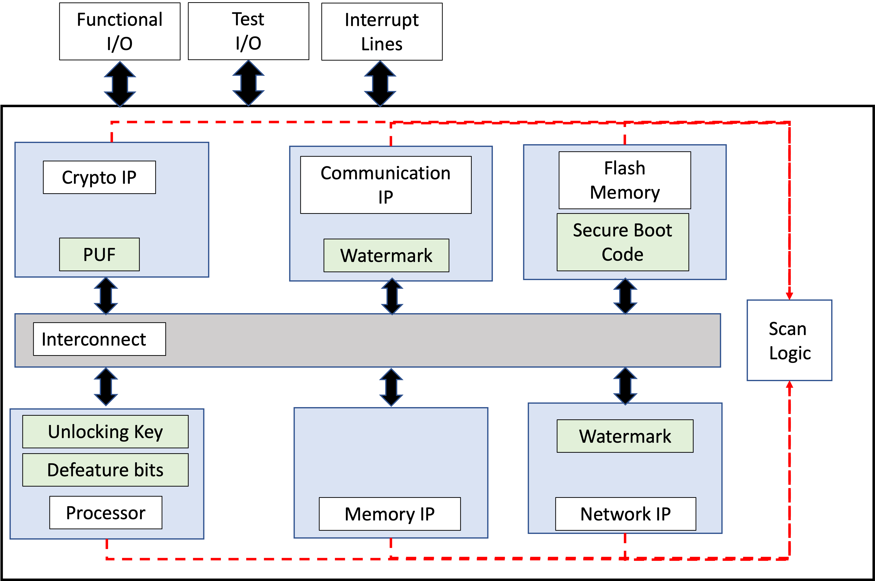
Challenges for Trustworthy Hardware
Challenge 6:
Modern systems contain multiple IPs each with their own security constraints
Each IP can have its own distinct threat model
Overall security = IP-level security + overall SoC security
IP functionality constraints have to be respected
Integrating security individually creates provisioning challenges
LinkedIn

Slide 17
Challenges for Trustworthy Hardware
Lack of a security metric
Resistant to Attacks
Overheads
Trustworthy Hardware
To Trust or not to Trust?
Resistant
To design
transformation
Lack of EDA-based security optimization
LinkedIn

